Slide 1
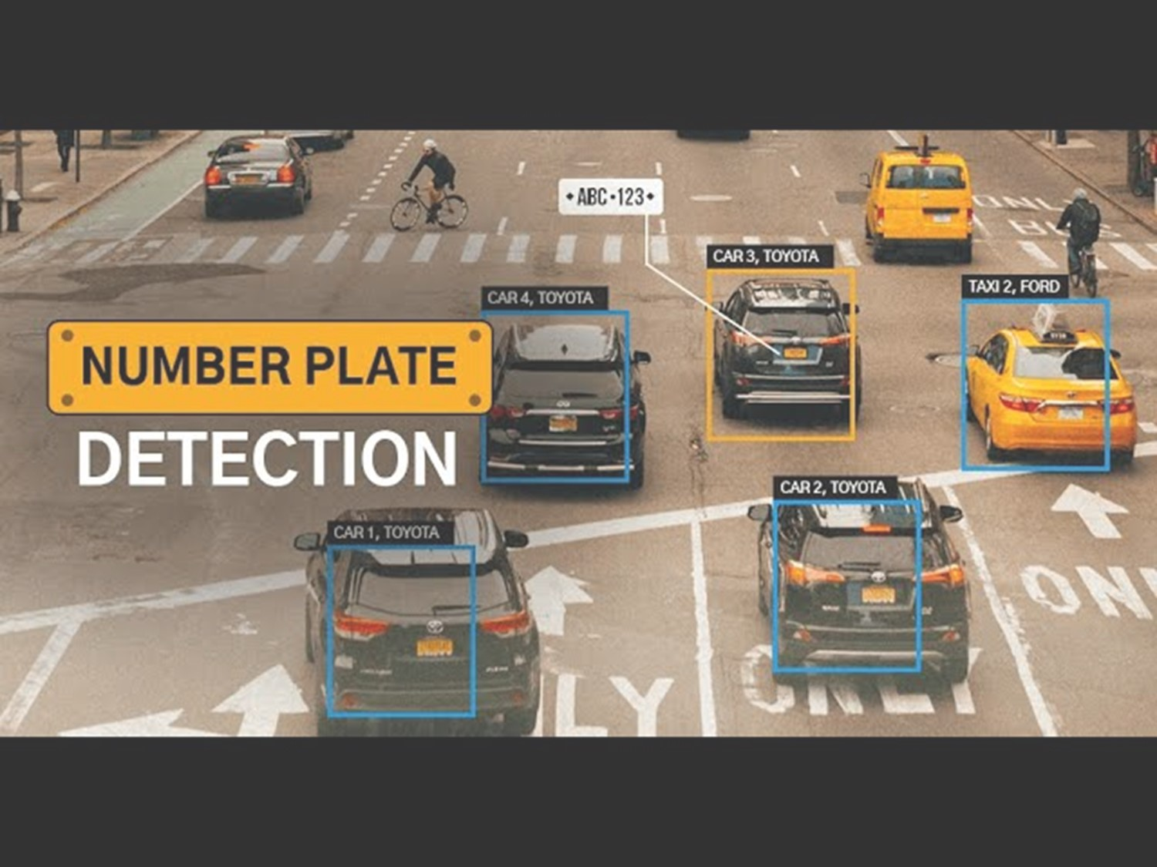
Campus 5s
PRJ ID-34

Slide 2





Team Members
Arjun Pushparaj
Athul Raj N
K Vivek Vardhan
P Varshith Sai
Pradeep P
TTC0822060
TTC0822021
NEC0822083
NEC0822038
NEC0822018

Slide 3
Introduction
Feasibility Study
Existing systems(Disadvantages)
Proposed system(Advantages)
Modules
Functionalities
conclusion

Slide 4
Introduction
Campus 5S, an innovative web application developed as part of college project to help streamline and validate the 5S practices within campus zones.
Administrators can track, audit, and manage campus zone cleanliness, organization, and efficiency in real-time, helping institutions maintain a well-kept environment in line with 5S standards.
This project demonstrates how technology can optimize campus management, fostering a more organized and productive learning environment. We hope you find our platform easy to use and insightful!

Slide 5
Introduction
5 s
5S is a Japanese methodology for organizing and maintaining a clean, efficient, and productive work environment, used widely in manufacturing and offices/ organization to improve productivity and quality.
Sort (Seiri)
Set in Order (Seiton)
Shine (Seiso)
Standardize (Seiketsu)
Sustain (Shitsuke

Slide 6
Feasibility Study

Slide 7
Feasibility Study
Technical Feasibility
Platform Design and Architecture: The Campus 5S web app will use modern technologies like HTML, CSS, JavaScript (React), and back-end frameworks (Node.js). A secure database (e.g., MySQL, MongoDB) will store campus zone, audit, and 5S data, accessible on desktop and mobile for real-time updates.
Maintenance:The platform is large or multiple-blocks in campus , with regular updates for smooth operation.

Slide 8
Feasibility Study
2. Operational Feasibility
Ease of Use: The platform will be user-friendly with an general interface. Administrators and staff can easily track, audit, and manage campus zones.
Staffing and Workflow Changes: The Campus 5S platform requires minimal workflow changes, with training and automated reports to reduce manual auditing.
Impact on Campus Management: The platform will streamline campus operations by providing real-time data on zone management and ensuring adherence to 5S principles.

Slide 9
Feasibility Study
3. Social Feasibility
Stakeholder Acceptance: Campus administrators and staff are likely to appreciate the benefits of the platform, particularly in terms of ease of use and improved efficiency in campus management. The platform is designed to be intuitive and easy to integrate into existing workflows.
User Feedback and Iterative Improvement: Feedback from initial users will be gathered to identify areas for improvement and ensure the platform evolves based on the needs of its users.

Slide 10
Feasibility Study
4. Requirements
Software Requirements:
Windows, Linux
Google Chrome, Mozilla Firefox, Brave, Microsoft Edge.
Hardware Requirements:
RAM 2GB
ROM 10GB

Slide 11
Feasibility Study
5. Requirements for developing
Software Requirements:
Windows, Linux
Any Web Browser, Visual Studio Code, My SQL/MongoDB, Node JS, Python/Django.
Hardware Requirements:
RAM 2GB
ROM 10GB

Slide 12
Existing Systems (Areas Used In)

Slide 13
Existing Systems (Areas used in)
CAMPUS ENVIRONMENT : to enhance organization, cleanliness, and overall efficiency.
HEALTHCARE : Hospitals use 5S to organize supplies, equipment, and records, ensuring cleanliness, order, and safety in high-stress environments.
OFFICE ENVIRONMENT: Offices use 5S to organize files, workstations, and digital resources, improving collaboration and workflow efficiency.

Slide 14
Existing Systems (Areas Used In)
Disadvantages of Existing System:
Time-Consuming: Manually auditing 5S with Excel is time-consuming, especially for large organizations or campuses with multiple departments and items to track.
Difficulty in Tracking Progress: Excel is not ideal for tracking 5S progress over time, making it difficult to monitor trends or changes without complex formulas and manual updates.
Data Security and Integrity Issues: Excel lacks strong data security and version control, risking unauthorized access, data loss, or corruption.

Slide 15
Existing Systems (Areas Used In)
Limited reporting and analytics: Excel's reporting features are limited, making it less suitable for generating reports or detailed 5S audit analysis compared to dedicated software.
Difficulty in Identifying Patterns and Trend: Manual auditing in Excel makes it difficult to identify patterns and trends in 5S, requiring advanced analytics or AI tools that Excel cannot provide without complex setups.

Slide 16
Proposed System (Advantages)

Slide 17
Advantages
Integration of Software : A centralized platform for managing 5S tasks, integrating software tools for efficient inventory tracking.
Real-Time Updates: A live dashboard provides real-time task tracking, updates on audit findings, and keeps stakeholders informed, improving coordination and reducing delays.
Improved Accountability: The platform assigns tasks with deadlines and logs task history and user actions for traceability

Slide 18
Advantages:
Eco-Friendly and Sustainable: The platform minimizes paperwork by digitizing processes and promotes a greener campus culture through the adoption of digital tools.
Scalability: The platform expands to accommodate campus growth and future-proofs the system for emerging technologies and evolving needs.

Slide 19
Modules

Slide 20
Modules
Data Collection and Preprocessing
Data Collection
Functionality: Collecting a diverse datasets of Zone Images, Cell images and zone Details with annotated Zone leaders.
Data Preprocessing
Normalize audit scores, structure observations, categorize performance (Red, Yellow, Green), and aggregate data for backend storage and UI.

Slide 21
Modules
2. User Interface
Application Interface: The dashboard displays zone performance with visual indicators, audit management provides forms for updating 5S data, and reports generate printable summaries of audits and Kaizen points
3. Database
Datasets: Store zone blocks, scores, remarks, audit history for trend analysis, and user details with roles in a single system.

Slide 22
Modules
4. Testing
Data Splitting
Functionality: It facilitates the division of the database into training, validation and testing sets to assess the performance of the model.
Real-Time Testing
Functionality: Simulate real-world use cases by adding audit observations, generating real-time performance scores, and validating user feedback mechanisms.

Slide 23
Modules
5. Integration
Integration with Backend
Connect the application interface to the database to fetch and update data.
Automate calculations for performance scoring and trend analysis.

Slide 24
Functionalities

Slide 25
Functionalities:
1. Zone Detection:
Detect and identify facility zones (e.g., COE, Admin, Canteen) and auto-assign them to responsible individuals for accountability.
2. Observation Localization
Identify problem areas (e.g., cluttered desks, misplaced tools) with visual markers and allow users to zoom in for better understanding.
3. Audit Score Recognition
Automatically extract audit scores for each 5S parameter and calculate overall zone performance by aggregating them.

Slide 26
Functionalities:
4. Accuracy and Feedback
Validate data consistency across zones, provide real-time performance feedback under varying conditions, and highlight areas needing immediate action.
5. User Interaction
Provide an intuitive interface for managing 5S audits, including zone performance views, detailed observations, easy editing, and report generation for sharing results.

Slide 27
Conclusion
The Campus 5S Web Application offers an innovative solution for implementing the 5S methodology, ensuring a cleaner, safer, and more organized campus with centralized data, real-time monitoring, and long-term sustainability to support a more efficient campus.

Slide 28
Thank
YOU

